Slide 1

COMP409: Compiler Design 1. Lexical Analysis
Instructor: Sushil Nepal, Assistant Professor
Block: 9-308
Email: sushilnepal@ku.edu.np
Contact: 9851-151617
Kathmandu University
Department of Computer Science and Engineering

Slide 2
Lexical Analysis
It is the initial part of reading and analyzing the program text
The text is read and divided into tokens, each of which corresponds to a symbol in programming language, e.g. a variable name, keyword or number, etc.
Lexical analyzer (also called lexer) will as its input take a string of individual letters and divide this string into tokens

Slide 3
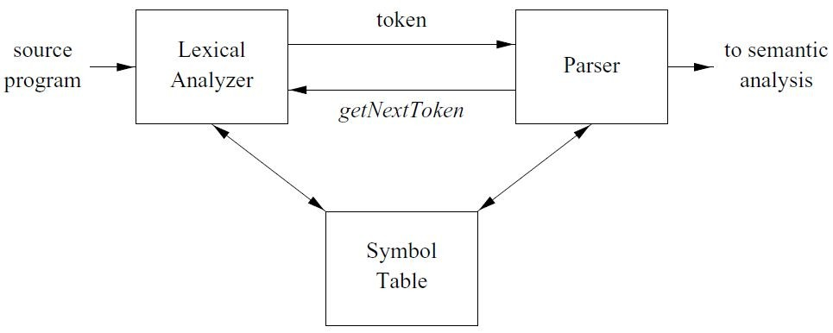
The Role of Lexical Analyzer

Slide 4
The Role of Lexical Analyzer
A lexical analyzer doesn’t return a list of tokens at once, it returns a token when the parser asks a token from it
The parser requests the lexical analyzer for the next token whenever it requires one using getnexttoken( )
On the receipt of the command, lexer scans the input and processes until a token is matched

Slide 5
The Role of Lexical Analyzer
The function of a lexical analyzer is to read the input stream representing the source program, one character at a time and to translate it into valid tokens
Lexical analyzer may also perform other operations like
removing redundant white spaces (i.e. blanks, tabs and newlines)
removing token separators (like semicolon)
removal of comments
providing line number to the parser for error reporting

Slide 6
Reasons for Separation of Lexical Analysis and Parsing
Simplicity of design is the most important consideration. The separation of lexical and syntactic analysis often allows us to simplify at least one of these tasks.
Compiler efﬁciency is improved. A separate lexical analyzer allows us to apply specialized techniques that serve only the lexical task, not the job of parsing.
Compiler portability is enhanced. Input-device-speciﬁc peculiarities can be restricted to the lexical analyzer.

Slide 7
Tokens, Patterns and Lexemes
Tokens
A token is a single word of source code input
A token is a pair consisting of a token name and an optional attribute value
Tokens are the separately identiﬁable blocks with collective meaning

Slide 8
Tokens, Patterns and Lexemes
When a string representing a program is broken into sequence of substrings, such that each substring represents a constant, identiﬁer, operator, keyword, etc of the language, these substrings are called the tokens of the language
They are the building block of the programming language
Eg: if, else, identiﬁers

Slide 9
Tokens, Patterns and Lexemes
Lexemes
Lexemes are the actual string matched as token
They are the speciﬁc characters that make up of a token
For example, abc and 123
A token can represent more than one lexeme. i.e. token intnum can represent lexemes 123, 244, 4545, etc

Slide 10
Tokens, Patterns and Lexemes
Patterns
Patterns are rules describing the set of lexemes belonging to a token
For example: “letter followed by letters and digits” and “non-empty sequence of digits”
Regular expressions are usually used to specify patterns
Eg: intnum token can be deﬁned as [0-9][0-9]*

Slide 11
Attributes for Tokens
When a token represents more than one lexeme, lexical analyzer must provide additional information about the particular lexeme
This additional information is called as the attribute of the token
Eg: If token id matched var1 and var2 both, then lexical analyzer must be able to represent var1 and var2 as different identiﬁers
For obtaining actual value, each token is associated with attribute, generally pointer to the symbol table

Slide 12
Attributes for Tokens
Some attributes:
<id, attr> where attr is pointer to the symbol table
<assignop,_> no attribute is needed (if there is only one assignment operator)
<num, val> where val is the actual value of the number
Eg: dest = source + 5
Tokens: <id, pt for dest>, <assignop>, <id, pt for source>, <num, 5>
Token type and its attribute uniquely identiﬁes a lexeme

Slide 13
Attributes for Tokens
Example: take statement,
area = 3.1416 * r * r
getnexttoken( ) returns (id, attr) where attr is pointer to area in symbol table
getnexttoken( ) returns (assignop) where no attribute is needed, if there is only one assignment operator
getnexttoken( ) returns (ﬂoatnum, 3.1416) where 3.1416 is the actual value of ﬂoatnum etc

Slide 14
Lexical Errors
Though error at lexical analysis is normally not common, there is possibility of errors
When error occurs, the lexical analyzer must not halt the process
It can print the error message and continue
Error in this phase is found when there are no matching strings found as given by the pattern

Slide 15
Lexical Errors
Some error recovery techniques
Deletion of extraneous character
Inserting missing character
Replacing incorrect character by correct one
Transposition of adjacent characters
Lexical error recovery is normally an expensive process
Recovery eg: ﬁnding the number of transformations that would make the correct tokens

Slide 16
Approaches to Implementing Lexical Analyzer
Use lexical analyzer generator like Flex that produces lexical analyzer from the given speciﬁcation as regular expression. The generator provides routine for reading and buffering the input.
Write a lexical analyzer in general programming language like C. We need to use the I/O facility of the language for reading and buffering the input.
Use the assembly language to write the lexical analyzer. Explicitly manage the reading of input.

Slide 17
Approaches to Implementing Lexical Analyzer
These strategies are in increasing order of difﬁculty and efﬁciency
Since we deal with characters in lexical analysis, it is better to take some time during implementation to get efﬁcient result

Slide 18
Input Buffering
Technique used to speed up reading the source program
There are many situations where we need to look at least one (if not more) additional character ahead to recognize lexemes in the input
For eg, int is a keyword in C but intnum is an identiﬁer so when the scanner reads i, n, t, it has to look for other characters to see whether it is just int or some other word

Slide 19
Input Buffering
In this case, when the token is read the next time, the scanner needs to move back to rescan the input again for the characters that are not used for the lexeme and this is time consuming
In C, single-character operators like -, =, or < could also be the beginning of a two-character operator like ->, ==, or <=
To reduce the overhead and efﬁciently move back and forth, input buffering technique is used

Slide 20
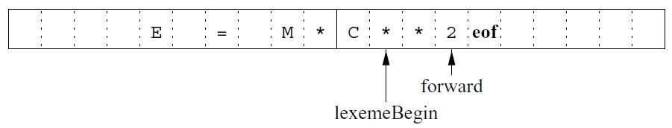
Buffer Pairs (2N Buffering)
Specialized buffering techniques have been developed to reduce the amount of overhead required to process a single input character

Slide 21
Buffer Pairs
Each buffer is of the same size N, and N is usually the size of a disk block, e.g., 4096 bytes
Using one system read command we can read N characters into a buffer, rather than using one system call per character
If fewer than N characters remain in the input ﬁle, then a special character, represented by eof marks the end of the source ﬁle

Slide 22
Buffer Pairs
Two pointers to the input are maintained:
Pointer lexemeBegin, marks the beginning of the current lexeme, whose extent we are attempting to determine
Pointer forward scans ahead until a pattern match is found
Once the next lexeme is determined, forward is set to the character at its right end
After the lexeme is recorded, lexemeBegin is set to the character immediately after the lexeme just found

Slide 23
Buffer Pairs
In the above ﬁgure, forward has passed the end of the next lexeme, and must be retracted one position to its left
Advancing forward requires that we ﬁrst test whether we have reached the end of one of the buffers, and if so, we must reload the other buffer from the input, and move forward to the beginning of the newly loaded buffer

Slide 24
Code to advance forward pointer:
if forward at end of first half then begin
reload second half;
forward := forward + 1
end
else if forward at end of second half then begin
reload first half;
move forward to beginning of first half
end
else forward := forward + 1;

Slide 25
Sentinels
If we use the 2N buffering scheme, we must check, each time we advance forward, that we have not moved off one of the buffers; if we do, then we must also reload the other buffer
Thus, for each character read, we make two tests: one for the end of the buffer, and one to determine what character is read

Slide 26
Sentinels
We can combine the buffer-end test with the test for the current character if we extend each buffer to hold a sentinel character at the end
The sentinel is a special character that cannot be part of the source program, and a natural choice is the character eof
eof retains its use as a marker for the end of the entire input
Any eof that appears other than at the end of a buffer means that the input is at an end

Slide 27
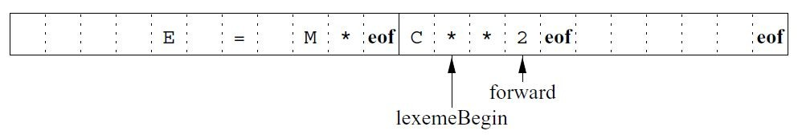
Sentinels

Slide 28
forward : = forward + 1;
if forward ↑ = eof then begin
if forward at end of first half then begin
reload second half;
forward := forward + 1
end
else if forward at end of second half then begin
reload first half;
move forward to beginning of first half end
else /* eof within a buffer signifying end of input */
terminate lexical analysis
end

Slide 29
Speciﬁcation of Tokens
Regular expression is the common way of specifying the patterns for tokens
Some Deﬁnitions:
Alphabet:
Set of symbols that generate language. For e.g.
{0-9} is an alphabet that is used to produce all the non-negative integer numbers
{0-1} is an alphabet that is used to produce all the binary strings

Slide 30
Speciﬁcation of Tokens
String:
Finite sequence of characters from the alphabet
Given the alphabet A, A²= A.A is set of strings of length 2, similarly A^{n} is set of strings of length n
The length of the string w is denoted by |w| i.e. number of characters (symbols) in w
We also have A⁰ ={ε}, where ε is called empty string

Slide 31
Speciﬁcation of Tokens
Kleene Closure:
Kleene closure of an alphabet A denoted by A* is set of all strings of any length (0 also) possible from A
Mathematically A* = A⁰ ∪ A¹ ∪ A² ∪ … …
For any string, w over alphabet A, w ∈ A*

Slide 32
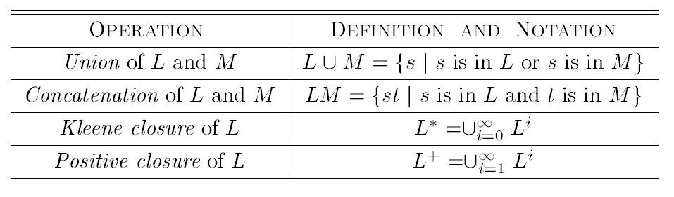
Speciﬁcation of Tokens

Slide 33
Speciﬁcation of Tokens
A language L over alphabet A is the set such that L ⊆ A*
The string s is called preﬁx of w, if the string s is obtained by removing zero or more trailing characters from w. If s is a proper preﬁx, then s ≠ w.
The string s is called sufﬁx of w, if the string s is obtained by deleting zero or more leading characters from w. We say s is a proper sufﬁx if s ≠ w.
The string s is called substring of w if we can obtain s by deleting zero or more leading or trailing characters from
w. We say s is a proper substring if s ≠ w.

Slide 34
Speciﬁcation of Tokens
Regular Operators:
The following operators are called regular operators and the language formed called regular language.
. → Concatenation operator, R.S = {rs | r ∈ R and s∈ S }
* → Kleene star operator, A* = ⋃_{i≥0} A^{i}
– + / ∪ / | → Choice/union operator, R ∪ S = {t | t ∈ R or t ∈ S }

Slide 35
Speciﬁcation of Tokens
Regular Expression (RE):
We use regular expression to describe the tokens of a programming language.
Basic Symbol
ε is a regular expression denoting language { ε }
a ∈ A is a regular expression denoting {a}

Slide 36
Speciﬁcation of Tokens
If r and s are regular expressions denoting languages L1(r) and L2(s) respectively, then
r + s is a regular expression denoting L1(r) ∪ L2(s)
rs is a regular expression denoting L1(r) . L2(s)
r* is a regular expression denoting (L1(r) )*
(r) is a regular expression denoting L1(r)

Slide 37
Speciﬁcation of Tokens
Practice Questions
RE in which every pair of adjacent zero’s appear before any pair of adjacent ones.
RE that gives binary strings having at most two 1s
RE that denotes the language of all strings that ends with 00 (binary number multiple of 4)
RE that denotes the set of all strings that describes alternating 1s and 0s

Slide 38
Speciﬁcation of Tokens
Answers
(a) (01)*(0011)(01)*
(b) 0*10*10* + 0*10* + 0*
(c) (1+0)*00
(d) (01)* + (10)*

Slide 39
Speciﬁcation of Tokens
Properties of RE
r+s = s+r ( + is commutative)
r+(s+t) = (r+s)+t ; r(st) = (rs)t (+ and . are associative)
r(s+t) = (rs)+(rt); (r+s)t =(rt)+(st) (. distributes over +)
εr = rε (ε is identity element)
r* = (r+ε)* (relation between * and ε)
r** = r* (* is idempotent)

Slide 40
Speciﬁcation of Tokens
Regular Deﬁnitions:
To write regular expression for some languages can be difﬁcult, because their regular expressions can be quite complex
In those cases, we may use regular deﬁnitions
We can give names to regular expressions, and we can use these names as symbols to deﬁne other regular expressions

Slide 41
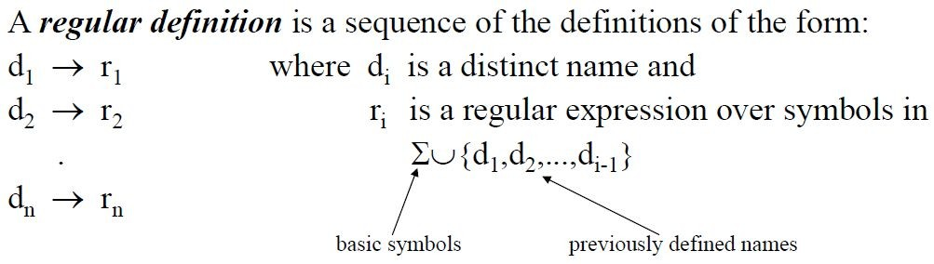
Speciﬁcation of Tokens

Slide 42
Speciﬁcation of Tokens
Identiﬁers in Pascal are deﬁned as a string of letters and digits beginning with a letter
letter → A | B | ... | Z | a |b| ... | z digit → 0 | 1 | ... | 9
id → letter (letter | digit ) *
If we try to write the regular expression representing identiﬁers without using regular deﬁnitions, that regular expression will be complex:
(A|...|Z|a|...|z) ( (A|...|Z|a|...|z) | (0|...|9) ) *

Slide 43
Recognition of Tokens
A recognizer for a language is a program that takes a string w, and answers “YES” if w is a sentence of that language, otherwise “NO”
The tokens that are speciﬁed using RE are recognized by using transition diagram or ﬁnite automata (FA)
Starting from the start state we follow the transition deﬁned

Slide 44
Recognition of Tokens
If the transition leads to the accepting state, then the token is matched and hence the lexeme is returned, otherwise other transition diagrams are tried out until we process all transition diagrams or failure is detected
Recognizer of tokens takes the language L and the string s as input and tries to verify whether s ∈ L or not

Slide 45
Recognition of Tokens
We concentrate on a class of recognizer called Finite Automata (FA)
There are two types of Finite Automaton:
Deterministic Finite Automaton (DFA)
Non Deterministic Finite Automaton (NFA)

Slide 46
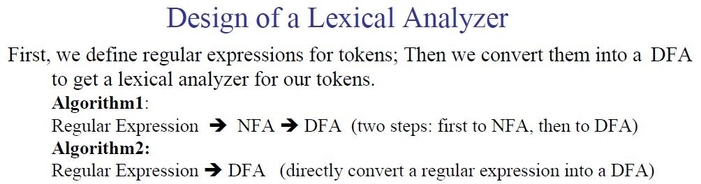
Recognition of Tokens

Slide 47
Recognition of Tokens
Why convert from NFA to DFA?
– Computer programs generally need to know all possible transitions and states for a given state machine.
A non-deterministic ﬁnite automaton can have a transition that goes to any number of states for a given input and state.
This is a problem for a computer program because it needs precisely one transition for a given input from a given state.
The process of converting NFA to DFA eliminates this ambiguity and allows a program to be made.

Slide 48
Deterministic Finite Automata (DFA)
FA is deterministic, if there is exactly one transition for each (state, input) pair
It is a fast recognizer but takes large space
DFA is a ﬁve tuple (S, ∑, q₀, δ, F) where,
S → ﬁnite set of states
∑ → ﬁnite set of input alphabets
q₀ → starting state
δ → transition function i.e. δ : S × ∑ → S
F → set of ﬁnal states F ⊆ S

Slide 49
Deterministic Finite Automata
The following is the algorithm for simulating DFA for recognizing given string
For a given string w, in DFA D, with start state q₀, with set of ﬁnal states F, the output is “YES”, if D accepts w, otherwise “NO”

Slide 50
DFASim(D, q₀) {
q = q₀
c = getchar( )
while (c != eof) {
q = move(q, c)
c = getchar( )
}
if (q is in F)
return “yes”
else
return “no”
}
// this is δ function.
// if D accepts w

Slide 51
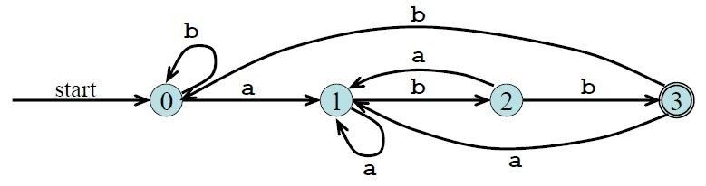
Deterministic Finite Automata
The ﬁgure shows DFA for the regular expression: (a+b)*abb

Slide 52
Practice Questions
Q) Write the regular expression and draw its corresponding DFA for the following:
Language accepting strings containing exactly two 0s over input alphabets ∑ = {0, 1}.
Language accepting strings starting and ending with different characters over input alphabets ∑ = {0, 1}.

Slide 53
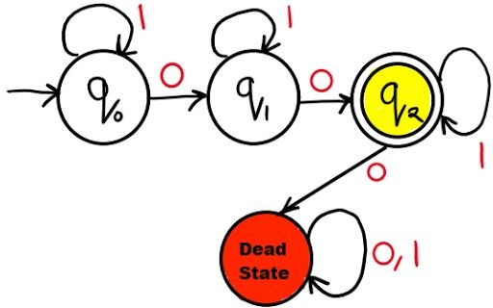
1*01*01*
Ans 1:

Slide 54
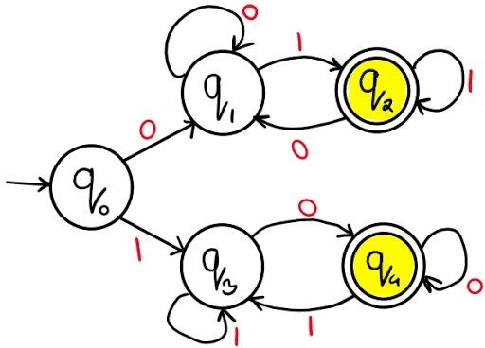
(0(0+1)*1)+(1(1+0)*0)
Ans 2:

Slide 55
Non-Deterministic Finite Automata (NFA)
FA is non-deterministic if there can be more than one transition (or none) for each (state, input) pair
It is a slow recognizer but takes less space
An NFA is a ﬁve tuple (S, ∑, q₀, δ, F) where,
S → ﬁnite set of states
∑ → ﬁnite set of input alphabets
q₀ → starting state
δ → transition function i.e. δ : S × ∑ → 2^{|S|}
– F → set of ﬁnal states F ⊆ S

Slide 56
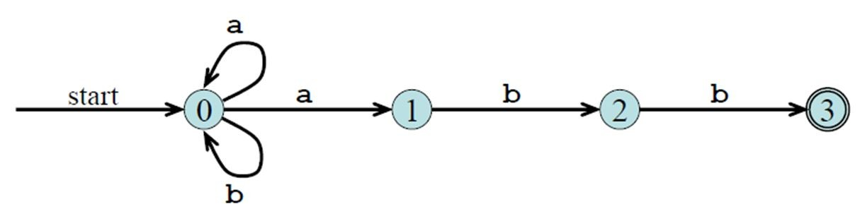
Non-Deterministic Finite Automata
The ﬁgure shows NFA for the regular expression: (a+b)*abb

Slide 57
Practice Questions
Design an NFA with ∑ = {0, 1} that accepts all strings in which the third symbol from the right end is always 0.
Design an NFA with ∑ = {0, 1} which accepts all strings containing the substring 1110.

Slide 58
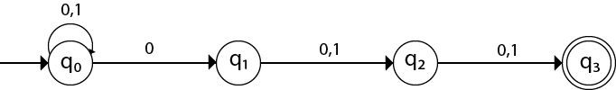
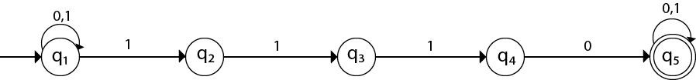
Ans 1:
Ans 2:

Slide 59
ε-NFA
ε-transitions are allowed in ε-NFAs
In other words, we can move from one state to another without consuming any symbol
In case of ε-NFA the only difference is ∑ = ∑ ∪ {ε} and hence δ: S × ∑ ∪ {ε} → 2^{|S|}

Slide 60
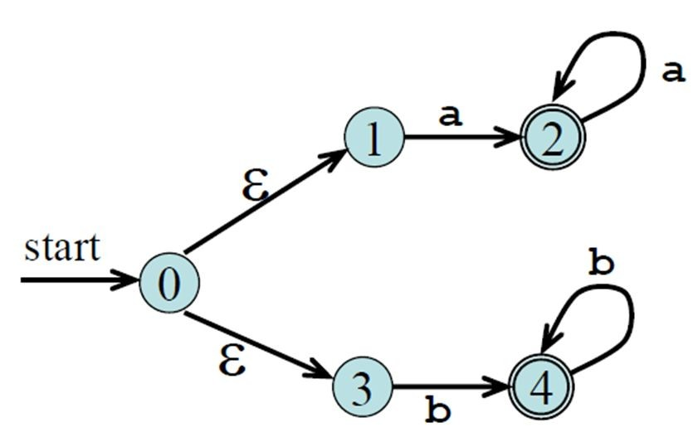
ε-NFA
The ﬁgure shows a state machine with ε moves that is equivalent to the regular expression: aa* +bb*

Slide 61
//SIMULATING NFA
S = ε-closure( {S₀} )
// set of all states that can be accessed from S₀ by ε- transitions
c = getchar( ) while(c != eof) {
S = ε-closure(move(S, c))
//set of all states that can be accessible from a state in S by a transition on c
c = getchar( )
}
if ( S ∩ F ≠ Φ) then
return “YES”
else
return “NO”

Slide 62
RE to NFA (Thompson’s Construction)
Thompson’s construction is a simple and systematic method
It guarantees that the resulting NFA will have exactly one ﬁnal state and one start state
Construction starts from simplest parts(alphabet symbols)
To create an NFA for a complex regular expression, NFAs of its subexpressions are combined

Slide 63
RE to NFA
Input → RE, r, over alphabet ∑
Output → ε-NFA accepting L(r)
Procedure → Process in bottom-up manner by creating ε-NFA for each symbol in ∑ including ε. Then recursively create for other operations as shown below.

Slide 64


RE to NFA
(1) To recognize an empty string ε
(2) To recognize a symbol a in the alphabet ∑

Slide 65
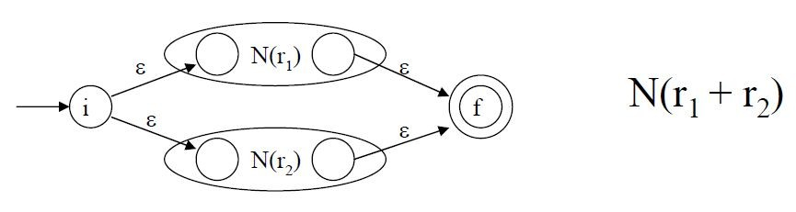
RE to NFA
(3) If N(r₁) and N(r₂) are NFAs for regular expressions r₁ and r₂
(A) For regular expression r₁ + r₂

Slide 66
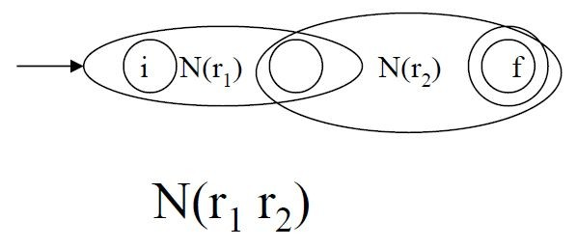
RE to NFA
(B) For regular expression r₁ . r₂
The start state of N(r₁) becomes the start state of N(r₁r₂) and ﬁnal state of N(r₂) become ﬁnal state of N(r₁r₂)

Slide 67
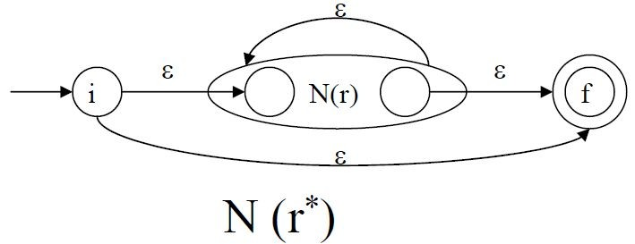
RE to NFA
(C) For regular expression r*
Using rules 1 and 2, we construct NFAs for each basic symbol in the expression; we combine these basic NFAs using rule 3 to obtain an NFA for the entire expression

Slide 68
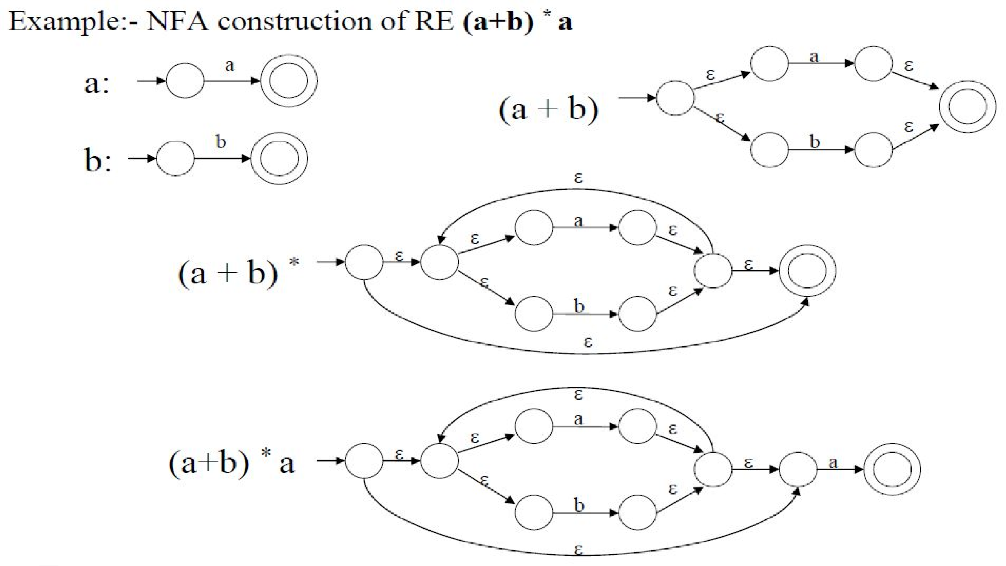

Slide 69
NFA to DFA (Subset Construction)
The subset construction algorithm converts an NFA into a DFA
We use the following operations to keep the track of sets of NFA
ε-closure(s) → the set of NFA states reachable from state s on ε- transition
ε-closure(T) → the set of NFA states reachable from state s in T on ε- transition
move(T, a) → the set of NFA states to which there is transition on input a from state s in T

Slide 70
NFA to DFA
The algorithm produces:
Dstates is the set of states of the new DFA consisting of sets of states of the NFA
Dtran is the transition table of the new DFA
The start state of DFA is ε-closure(q₀)
A set of Dstates is an accepting state of DFA if it is a set of NFA states containing at least one accepting state of NFA

Slide 71
Algorithm
Put ε-closure(q₀) as an unmarked state in Dstates
While there is an unmarked state T in Dstates do
Mark T
For each input symbol a ∈ ∑ do
U = ε-closure(move(T, a))
If U is not in Dstates then
Add U as an unmarked state to Dstates
End if
Dtran[T, a] = U
End do
End do

Slide 72
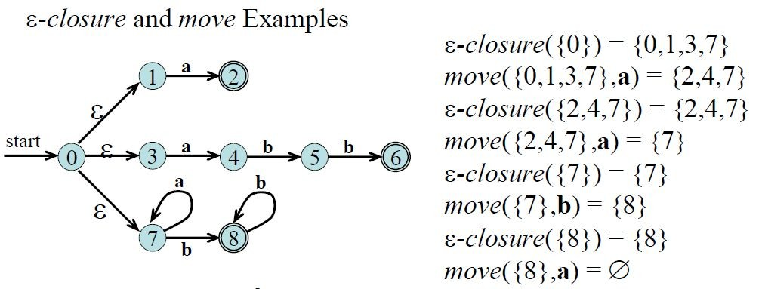

Slide 73
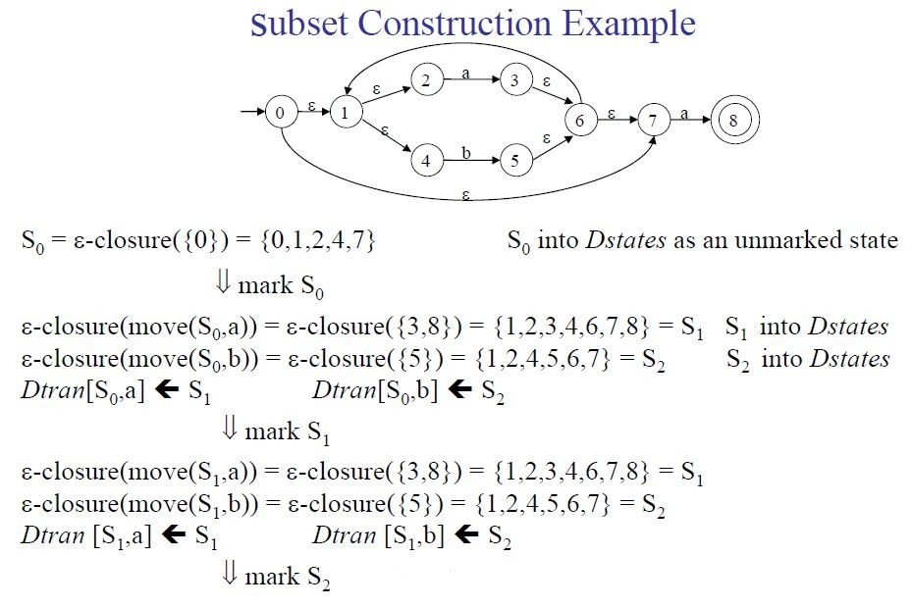

Slide 74
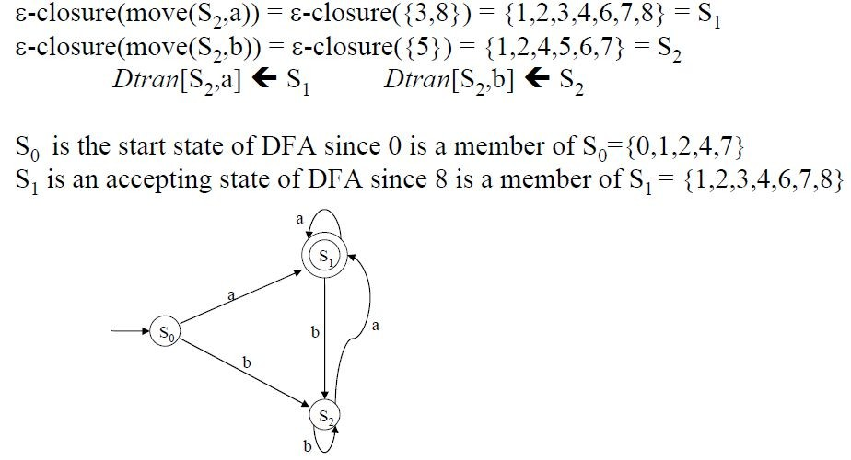

Slide 75
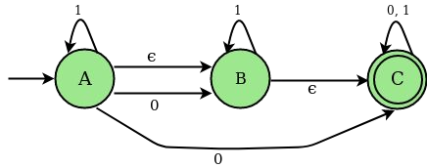
Practice Question
Q) Convert the following NFA to DFA:

Slide 76
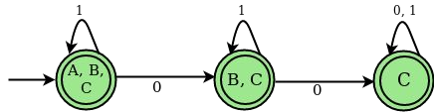
Practice Question
Ans:

Slide 77
RE to DFA (directly)
Important States:
The “important states” of an NFA are those without a null transition; that is, if move({s},a) ≠ ø for some a, then s is an important state
In an optimal state machine, all states are important states
The subset construction algorithm uses only the important states when it determines
ε-closure(move(T,a))

Slide 78
RE to DFA
Augmented Regular Expression:
The ε-NFA created from RE has exactly one accepting state and it does not have any transition i.e. it is not important state
We introduce an “augmented character” # from the accepting state to make it an important state
The regular expression (r)# is called the augmented regular expression of the original expression r

Slide 79
Procedure:
Augment the given regular expression by concatenating it with special symbol # i.e r → (r)#
Create the syntax tree for this augmented regular expression
In this syntax tree, all alphabet symbols (plus # and the empty string) in the augmented regular expression will be on the leaves, and all inner nodes will be the operators in that augmented regular expression.
Then each alphabet symbol (plus #) will be numbered (position numbers)
Traverse the tree to construct functions nullable, ﬁrstpos, lastpos, and followpos
Finally construct the DFA from the followpos

Slide 80
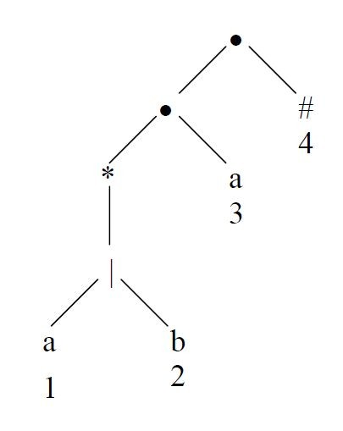
Syntax Tree Construction:
(a|b)*a → (a|b)*a# [augmented regular expression]
Syntax tree of (a|b)*a#
each symbol is numbered (positions)
each symbol is at a leaf
inner nodes are operators

Slide 81
ﬁrstpos, lastpos, nullable
To evaluate followpos, we need three functions to deﬁne the nodes (not just for leaves) of the syntax tree:
ﬁrstpos(n) → the set of the positions of the ﬁrst symbols of strings generated by the sub-expression rooted by n
lastpos(n) → the set of the positions of the last symbols of strings generated by the sub-expression rooted by n
nullable(n) → true if the empty string is a member of strings generated by the sub-expression rooted by n, false otherwise

Slide 82
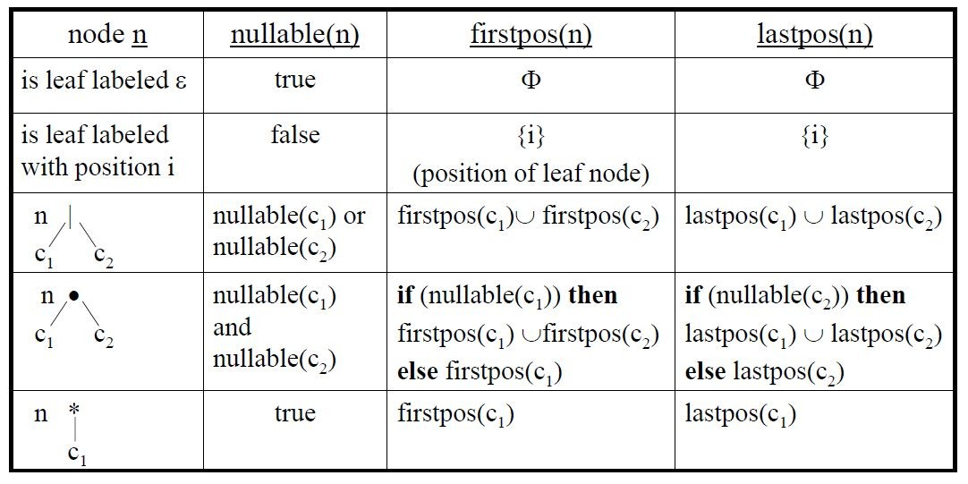
Rules for calculating nullable, ﬁrstpos & lastpos

Slide 83
.
a.b.(a+b)*.(a+b)*.b.a.#
1 2 3 4 5 6 7 8 9
.
#
.
a
9
8
b
.
7
.
*
.
*
+
a
b
+
a
b
1
2
5
6
a
b
3
4
Compute nullable, firstpos, lastpos
Compute followpos
Construct DFA

Slide 84
R4:{f},{1,2},{12}
.
(a+ε)ab(aba+bb)*b(a+b)*#
1 23 456 78 9 10 11 12
R4:{f},{1,2},{9,10,11}
#
.
R4:{f},{1,2},{9}
12
.
R2:{f},{12},{12}
R4:{f},{1,2},{3,6,8}
{nullable},{firstpos},{lastpos}
.
*
R5:{t},{10,11},{10,11}
R4:{f},{1,2},{3}
.
b
R2:{f},{9},{9}
9
.
R5:{t},{4,7},{6,8}
*
|
R4:{f},{1,2},{2}
R3:{f},{10,11},{10,11}
b
a
R3:{t},{1},{1}
|
a
b
R3:{f},{4,7},{6,8}
10
2
3
|
11
R2:{f},{3},{3}
R2:{f},{10},{10}
a
ε
R2:{f},{2},{2}
R2:{f},{11},{11}
1
R1:{t},{Φ},{Φ}
.
.
R4:{f},{4},{6}
R4:{f},{7},{8}
R2:{f},{1},{1}
.
a
R4:{f},{4},{5}
b
b
6
R2:{f},{6},{6}
7
8
a
b
R2:{f},{8},{8}
Compute followpos(i)
Compute DFA
4
5
R2:{f},{7},{7}
R2:{f},{4},{4}
R2:{f},{5},{5}

Slide 85
Evaluating followpos
for each node n in the tree do
if n is a cat-node with left child c1 and right child c2 then for each i in lastpos(c1) do
followpos(i) := followpos(i) ∪ ﬁrstpos(c2)
end do
else if n is a star-node
for each i in lastpos(n) do
followpos(i) := followpos(i) ∪ ﬁrstpos(n)
end do end if
end do
Compute the followpos bottom-up for each node of Syntax tree

Slide 86
followpos
We deﬁne the function followpos for the positions (positions assigned to leaves)
followpos(i) → is the set of positions which can follow the position i in the strings generated by the augmented regular expression
For example, ( a | b)* a #
1 2 3 4
followpos(1) = {1, 2, 3}
followpos(2) = {1, 2, 3}
followpos(3) = {4}
followpos(4) = { }

Slide 87
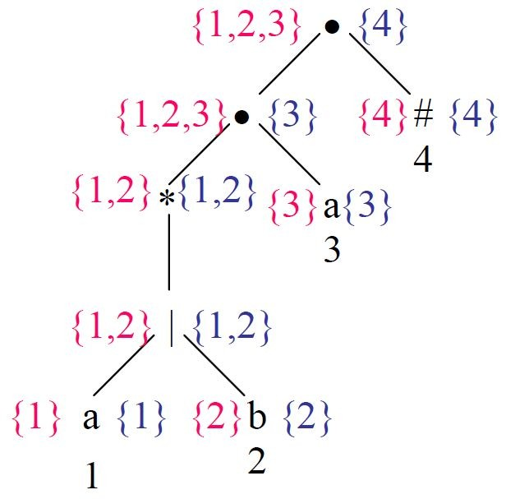
Evaluating followpos example:
red – firstpos
blue – lastpos
Then we can calculate followpos
followpos(1) = {1,2,3}
followpos(2) = {1,2,3}
followpos(3) = {4} followpos(4) = { }
After we calculate followpos, we are ready to create DFA for the regular expression

Slide 88
Algorithm for converting RE to DFA
Create the syntax tree of (r)#
Calculate the functions: nullable, ﬁrstpos, lastpos & followpos
Put ﬁrstpos(root) into the states of DFA as an unmarked state

Slide 89
4. while (there is an unmarked state S in the states of DFA) do
mark S
for each input symbol a do
let s1,...,sn are positions in S and symbols in those positions is a
S’ ← followpos(s1) ∪ ... ∪ followpos(sn)
move(S, a) ← S’
if (S’ is not empty and not in the states of DFA)
– put S’ into the states of DFA as an unmarked state
The start state of DFA is ﬁrstpos(root)
The accepting states of DFA are all states containing the position of #

Slide 90
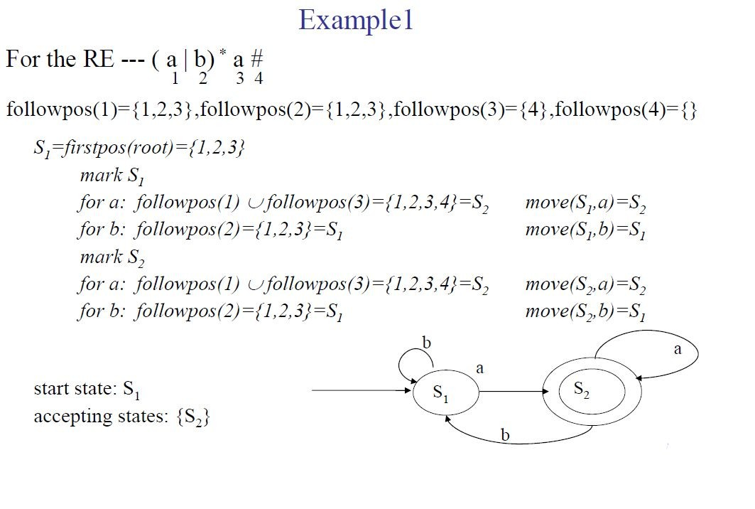

Slide 91
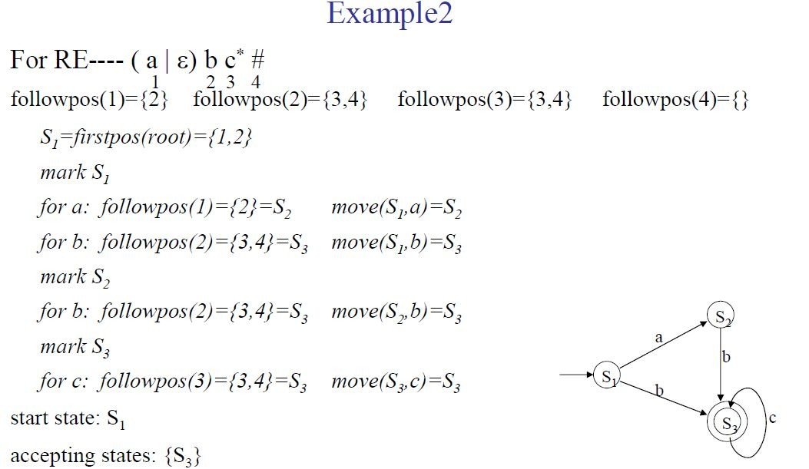

Slide 92
State Minimization in DFA
DFA minimization refers to the task of transforming a given DFA into an equivalent DFA which has minimum number of states
Two states p and q are called equivalent if for all input strings w, δ(p, w) is an accepting state iff δ(q,w) is an accepting state
Otherwise they are called distinguishable states

Slide 93
State Minimization in DFA
String w distinguishes state s from state t if, by starting with DFA M in state s and feeding it input w, we end up in an accepting state, but starting in state t and feeding it with same input w, we end up in a non accepting state, or vice-versa
The procedure ﬁnds the states that can be distinguished by some input string
Each group of states that cannot be distinguished is then merged into a single state

Slide 94
State Minimization in DFA
Suppose there is a DFA D < Q, Σ, q₀, δ, F > which recognizes a language L. Then the minimized DFA D
<Q’, Σ, q₀, δ’, F’ > can be constructed for language L as:
Step 1: Divide Q (set of states) into two sets. One set will contain all ﬁnal states and the other set will contain all non-ﬁnal states. This partition is called P₀.
Step 2: Initialize k = 1

Slide 95
State Minimization in DFA
Step 3: Find P_{k} by partitioning the different sets of P_{k-1}. In each set of P_{k-1}, take all possible pair of states. If two states of a set are distinguishable, split the states into different sets in P_{k}.
Step 4: Stop when P_{k} = P_{k-1} (No change in partition)
Step 5: All states of one set are merged into one. No. of states in minimized DFA will be equal to no. of sets in P_{k}.

Slide 96
State Minimization in DFA
In addition to the procedure, we also remove the following states from the DFA:
Unreachable State: A state that cannot be reached through any transition from any other state in the DFA
Dead State: A non-ﬁnal state, that when an automata reaches, cannot transit into any other state

Slide 97
State Minimization in DFA
How to ﬁnd whether two states in partition P_{k} are distinguishable?
– Two states ( qi, qj ) are distinguishable in partition P_{k} if for any input symbol a, δ( qi, a ) and δ( qj, a ) are in different sets in partition P_{k-1}

Slide 98
State Minimization in DFA
Start state of the minimized DFA is the group containing the start state of the original DFA
Accepting states of the minimized DFA are the groups containing the accepting states of the original DFA

Slide 99
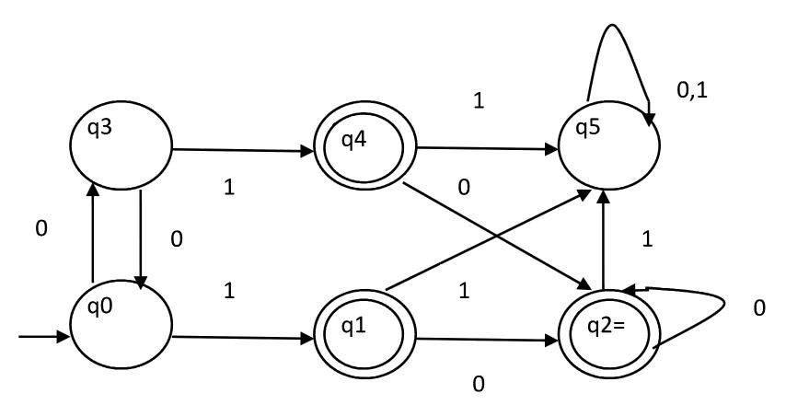
Example
Consider the following DFA shown in ﬁgure.

Slide 100
1. P₀ will have two sets of states. One set will contain q1, q2, q4 which are ﬁnal states of DFA and another set will contain remaining states. So P₀ = { { q1, q2, q4 }, { q0, q3, q5 } }.
2. To calculate P₁, we will check whether sets of partition P₀ can be partitioned or not:
For set { q1, q2, q4 } :
δ ( q1, 0 ) = δ ( q2, 0 ) = q2 and δ ( q1, 1 ) = δ ( q2, 1 ) = q5, So q1 and q2 are not distinguishable.
Similarly, δ ( q1, 0 ) = δ ( q4, 0 ) = q2 and δ ( q1, 1 ) = δ ( q4, 1 ) = q5, So q1 and q4 are not distinguishable.
Since, q1 and q2 are not distinguishable and q1 and q4 are also not distinguishable, So q2 and q4 are not distinguishable. So, { q1, q2, q4 } set will not be partitioned in P₁.
For set { q0, q3, q5 } :
δ ( q0, 0 ) = q3 and δ ( q3, 0 ) = q0 δ ( q0, 1) = q1 and δ( q3, 1 ) = q4

Slide 101
Moves of q0 and q3 on input symbol 0 are q3 and q0 respectively which are in same set in partition P₀. Similarly, Moves of q0 and q3 on input symbol 1 are q1 and q4 which are in same set in partition P₀. So, q0 and q3 are not distinguishable.
δ ( q0, 0 ) = q3 and δ ( q5, 0 ) = q5 and δ ( q0, 1 ) = q1 and δ ( q5, 1 ) = q5 Moves of q0 and q5 on input symbol 1 are q1 and q5 respectively which are in different sets in partition P₀. So, q0 and q5 are distinguishable. So, set { q0, q3, q5 } will be partitioned into { q0, q3 } and { q5 }. So,
P₁ = { { q1, q2, q4 }, { q0, q3}, { q5 } }
To calculate P₂, we will check whether sets of partition P₁ can be partitioned or not:
iii)For set { q1, q2, q4 } :
δ ( q1, 0 ) = δ ( q2, 0 ) = q2 and δ ( q1, 1 ) = δ ( q2, 1 ) = q5, So q1 and q2 are not distinguishable.

Slide 102
Similarly, δ ( q1, 0 ) = δ ( q4, 0 ) = q2 and δ ( q1, 1 ) = δ ( q4, 1 ) = q5, So q1 and q4 are not distinguishable.
Since, q1 and q2 are not distinguishable and q1 and q4 are also not distinguishable, So q2 and q4 are not distinguishable. So, { q1, q2, q4 } set will not be partitioned in P₂.
iv)For set { q0, q3 } :
δ ( q0, 0 ) = q3 and δ ( q3, 0 ) = q0
δ ( q0, 1 ) = q1 and δ ( q3, 1 ) = q4
Moves of q0 and q3 on input symbol 0 are q3 and q0 respectively which are in same set in partition P₁. Similarly, Moves of q0 and q3 on input symbol 1 are q1 and q4 which are in same set in partition P₁. So, q0 and q3 are not distinguishable.
v) For set { q5 }:
Since we have only one state in this set, it can’t be further partitioned. So,
P₂ = { { q1, q2, q4 }, { q0, q3 }, { q5 } }

Slide 103
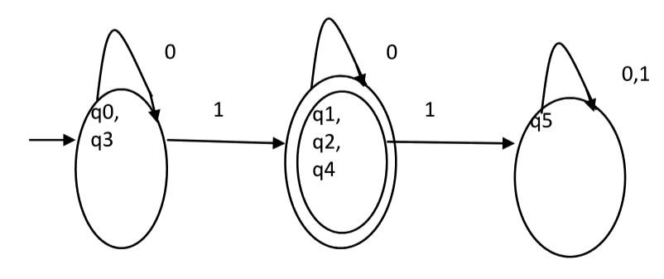
Here, P₁=P₂. So, this is the ﬁnal partition. Partition P₂ means that q1, q2 and q4 states are merged into one. Similarly, q0 and q3 are merged into one. Minimized DFA corresponding to the given input DFA is shown below:

Slide 104
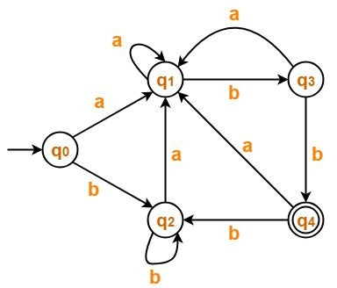
Practice Question
Q) Minimize the following DFA:

Slide 105
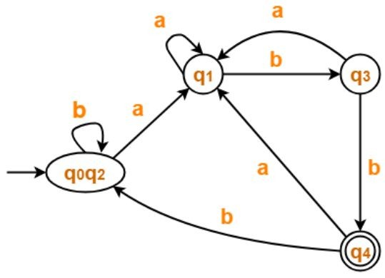
Ans:

Slide 106
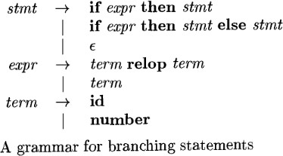
Summary: Specification and Recognization
Consider the following grammar:

Slide 107
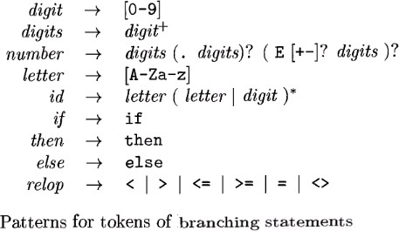
Tokens in the above grammar are:
Whitespace is identified as shown below:

Slide 108
REGULAR-EXPRESSION PATTERNS FOR TOKENS
Regular Expression | Token | Attribute-value
ws | -- | --
if | if | --
then | then | --
id | id | pointer to table entry
num | num | pointer to table entry
< | relop | LT
<= | relop | LE
= | relop | EQ
<> | relop | NE
> | relop | GT
>= | relop | GE

Slide 109
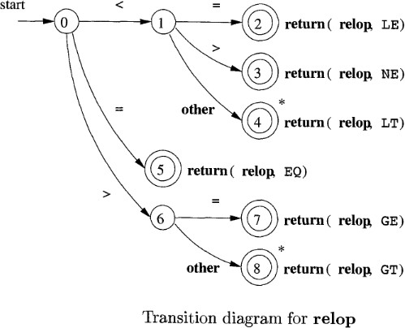
In the construction of lexical analyzer we first convert the patterns into flowcharts called “transition diagrams”.

Slide 110
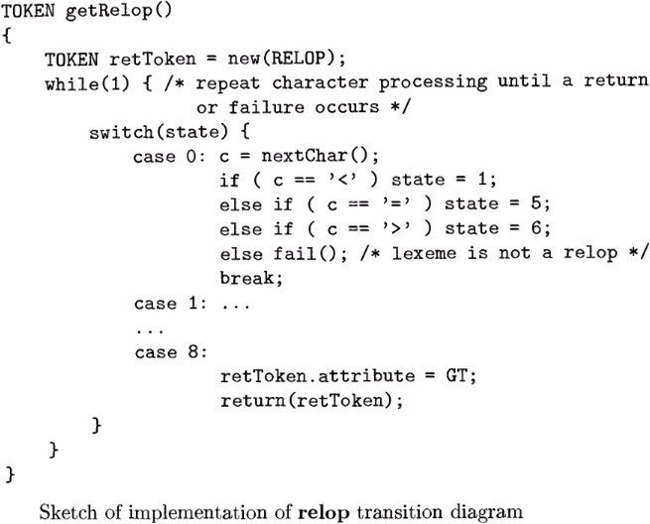
Implementation of Transition diagram

Slide 111
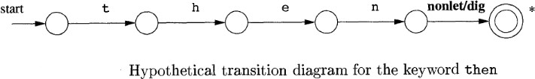
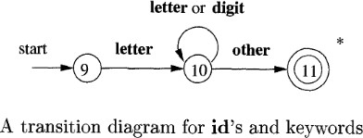

Slide 112
